Slide 1

Reporting and Analyzing Inventories
5
Chapter
UAA – ACCT 201 Principles of Financial Accounting Dr. Fred Barbee

Slide 2
Day #2
IS FUN!
ACCOUNTING
ACCT 201 ACCT 201 ACCT 201

Slide 3
Chapter 5 - Day 2 - Agenda
Topic | LO | Read | HW
Inventory Items and Cost | C1, C2 | 219-220 | QS5, QS7
Other Inventory Valuations | P2, P3 | 220-223 | E7, E8, P3A
Decision Analysis | A3 | 224-225 | QS12, E9, E10
P5-2A due today!

Slide 4
Reporting and Analyzing Inventories
5
Chapter
Inventory Items and Costs

Slide 5
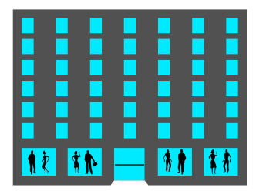


Items in Merchandise Inventory
FOB Shipping Point
Public
Carrier
Seller
Buyer
Ownership passes
to the buyer here.
Public
Carrier
Seller
FOB Destination Point
Buyer

Slide 6


Items in Merchandise Inventory
Goods on Consignment
  Goods shipped by the owner (consignor) to another party (consignee).
  Merchandise is included in the inventory of the consignor.

Slide 7
Items in Merchandise Inventory
Goods Damaged or Obsolete
  Damaged or obsolete goods are not counted in inventory.
  Cost should be reduced to net realizable value.

Slide 8

Cost of Merchandise Inventory
Insurance
Invoice Price
Freight-in
Import Duties
Storage
Include all expenditures necessary to bring an item to a salable condition and location.

Slide 9

Physical Count of Merchandise Inventory
Most companies take a physical count of inventory at least once each year.
Inventory
Count Tag
Quantity ___
Counted
by _______

Slide 10
Physical Count of Merchandise Inventory
When the physical count does not match the Merchandise Inventory account, an adjustment must be made.
Inventory
Count Tag
Quantity ___
Counted
by _______

Slide 11
Reporting and Analyzing Inventories
5
Chapter
Other Inventory Valuations

Slide 12
Other Inventory Valuations
Lower of Cost or Market

Slide 13
Lower of Cost or Market
Inventory must be reported at market value when market is lower than cost.
ACCT 201 ACCT 201 ACCT 201
Market is defined as current replacement cost (not sales price).
Consistent with the conservatism
principle.

Slide 14
Lower of Cost or Market
Can be applied three ways:
  separately to each individual item.
  to major categories of assets.
  to the whole inventory.

Slide 15
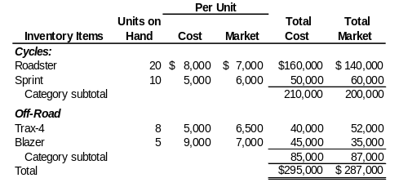
Lower of Cost or Market
A motorsports retailer has the following items in inventory (Exhibit 5.14) :

Slide 16
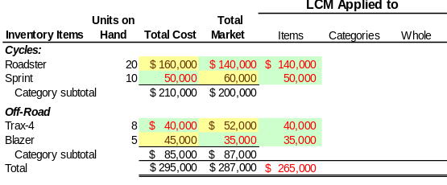
Lower of Cost or Market
Here is how to compute lower of cost or market for individual inventory items.

Slide 17
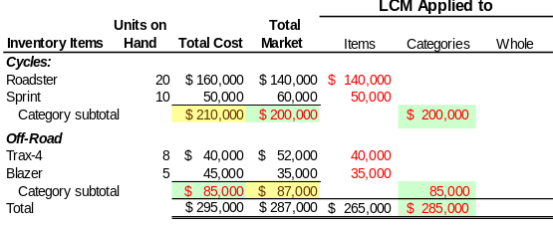
Lower of Cost or Market
Here is how to compute lower of cost or market for the two groups of inventory items.

Slide 18
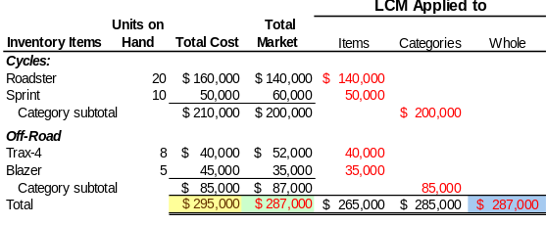
Lower of Cost or Market
Here is how to compute lower of cost or market for the entire inventory.

Slide 19
Other Inventory Valuations
Retail Inventory Method

Slide 20

Retail Inventory Method
Often used to estimate inventory for interim period reporting.
Needed Information includes:
  Beginning inventory at cost and retail
  Net purchases at cost and retail
  Net sales

Slide 21
Retail Inventory Method
Goods available for sale at retail
Net sales at retail
Ending inventory at retail
Step 1
–
=
Goods available for sale at cost
Goods available for sale at retail
Cost to retail ratio
Step 2
÷
=
Ending inventory at retail
Cost to retail ratio
Estimated ending inventory at cost
Step 3
×
=

Slide 22
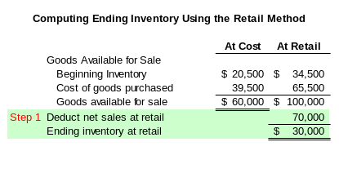
Retail Inventory Method

Slide 23
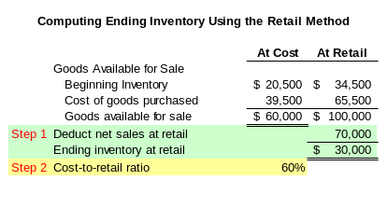
Retail Inventory Method

Slide 24
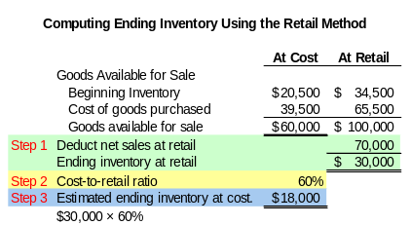
Retail Inventory Method

Slide 25
Other Inventory Valuations
Gross Profit Method

Slide 26
Gross Profit Method
Estimate ending inventory by applying the gross profit ratio to net sales (at retail).
Useful when inventory has been destroyed, lost, or stolen.

Slide 27
Gross Profit Method
Net sales at retail
1.0 – the gross profit ratio
Estimated cost of goods sold
Step 1
×
=
Goods available for sale at cost
Estimated cost of goods sold
Estimated ending inventory at cost
Step 2
–
=

Slide 28

Gross Profit Method
  In March of 2002, Chemical Company’s inventory was destroyed by fire. Chemical’s normal gross profit ratio is 30% of net sales. At the time of the fire, Chemical showed the following balances:
ACCT 201 ACCT 201 ACCT 201

Slide 29
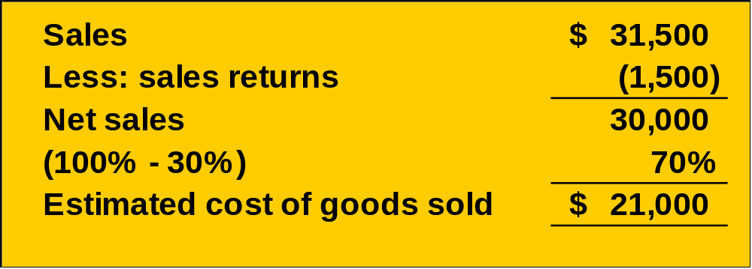
Gross Profit Method
Step 1

Slide 30
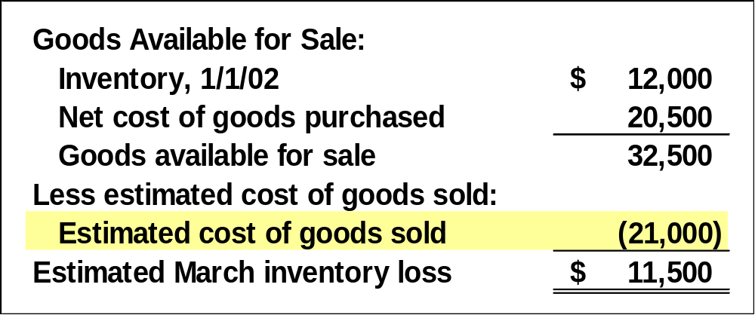
Gross Profit Method
Step 2

Slide 31
Reporting and Analyzing Inventories
5
Chapter
Decision Analysis

Slide 32
Inventory Turnover
Shows how many times a company turns over its inventory during a period. Indicator of how well management is controlling the amount of inventory available.
Inventory
Cost of goods sold
=
Turnover
Avg. inventory

Slide 33
Days’ Sales in Inventory
Reveals how much inventory is available in terms of the number of days’ sales.
Days' Sales in
Ending Inventory
=
×
365
Inventory
Cost of goods sold

